Slide 1
WELCOME
Class: B.Com – Part-1
Subject: Financial Accounting
TOPIC: Accounting Cycle and Journal
Prepared By
Dr. SHAHID IQBAL
Guest Faculty
Marwari College, Darbhanga,
Mobile No. and Whatsup No. : 7004160257
Email ID: shahidlnmu@gmail.com

Slide 2
Accounting Cycle
The accounting cycle is a series of steps starting with recording business transactions and leading up to the preparation of financial statements. This financial process demonstrates the purpose of financial accounting–to create useful financial information in the form of general-purpose financial statements.

Slide 3
Key Features of Accounting Cycle
The accounting cycle includes identifying and recording accounting events.
The cycle is a set of rules and steps to ensure financial statements are prepared accurately and timely.
The first step in the eight-step accounting cycle is to record transactions using journal entries, ending with the eighth step of closing the books after preparing financial statements.

Slide 4
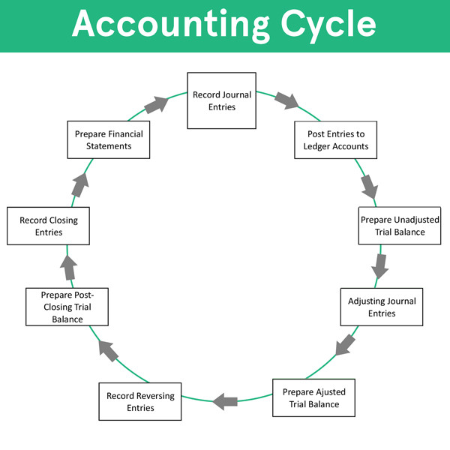

Slide 5
Journal (Book of Original Entry)
A journal is a book in which transactions are recorded in the order in which they occur. A Journal is called a book of prime entry also called original entry because all business transactions are entered first in this book. The process of recording a transaction in a journal is called Journalizing. An entry made in the journal is called a Journal Entry.

Slide 6
Simple and Compound Journal Entries
The journal entry is the basic record of a business transaction. It may be simple or compound.
Simple entry when only two accounts are involved to record a transaction, it is called a simple journal entry. In this one account is debited and another account is credit with an equal amount.
Compound entry when the number of accounts to be debited and credit is more than one, entry made for recording the transaction is called compound journal entry. In other words, it involves multiple accounts.

Slide 7
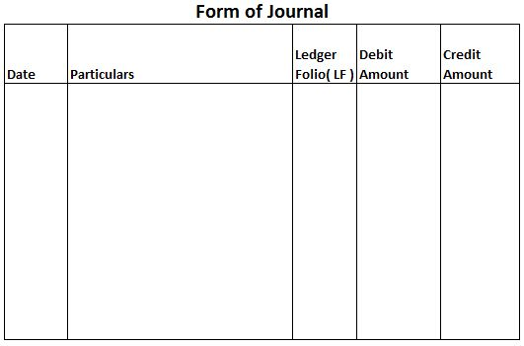
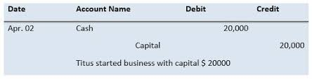
Format of Journal Entries

Slide 8
Thank You

